Slide 1
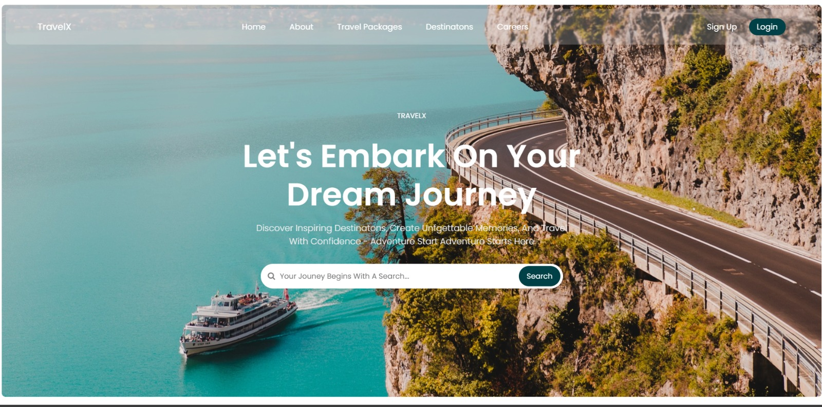

TravelX
Travel Itinerary Website

Slide 2
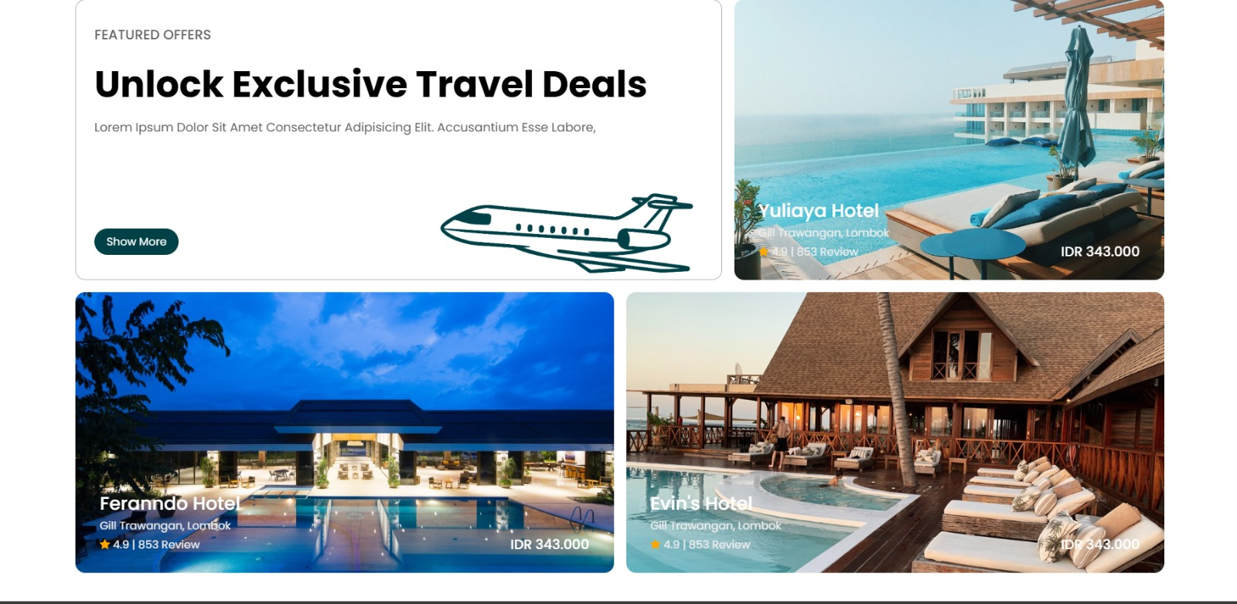

Introduction
Effortless travel planning with a user-friendly interface.
1
Personalized Itineraries
Tailored to your interests and budget.
Budget Tracking
Monitor and manage travel expenses
effectively.
2
3
Local Guides & Tours
Discover hidden gems and authentic
experiences.
4
Adventurer’s voice
Reviews from from our adventurous customers

Slide 3


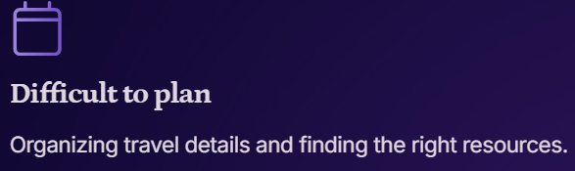

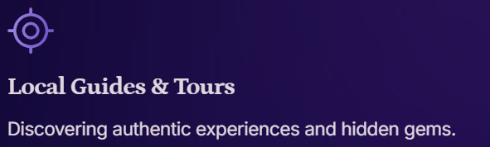
Planning vacations can be challenging and time-consuming.

Slide 4

Solution Overview
Our website solves these challenges with a comprehensive suite of tools.
Personalized Itineraries
Create customized travel plans with ease.
Budget Tracking
Monitor your expenses and stay within budget.
Local Guides & Tours
Access curated local guides and tour options.

Slide 5

Personalized Travel Itinerary
Create itineraries tailored to your preferences and interests.
1
Destination Selection
Choose your preferred destinations based on
location, interests, and travel dates.
2
Itinerary Planning
Add activities, attractions, and
accommodation options to your itinerary.
3
Real-time Updates
Receive personalized recommendations and a
alerts for travel planning.

Slide 6

Expense Tracker
Manage your travel budget efficiently.
Set Budget
Track Expenses
Define a total budget for your trip.
1.Accomodation
2. Food & Drinks
3. Activities
4. Transportation
Record expenses in real-time.
Visual Reports
Gain insights into your spending habits.

Slide 7
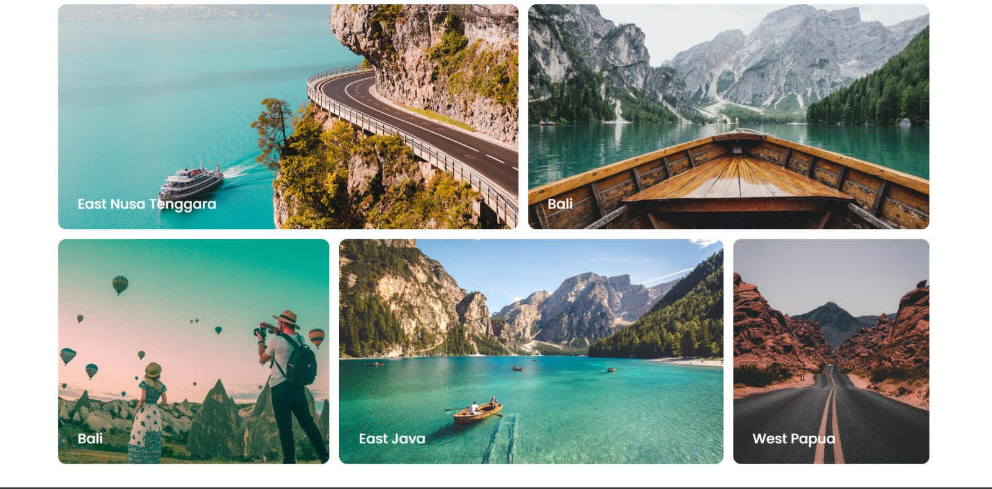
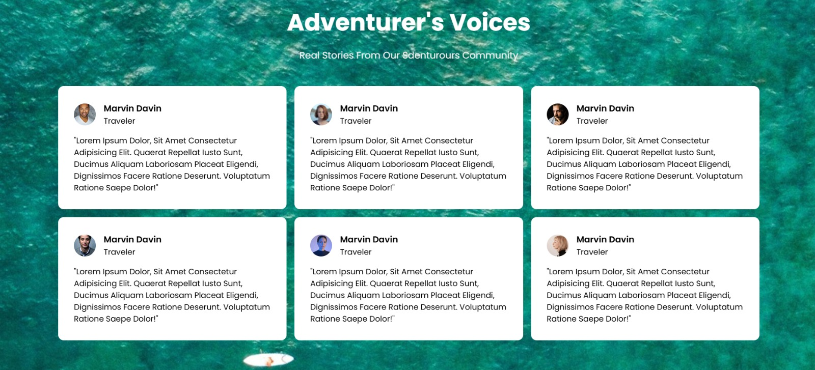
Local Travel Guides & Tours
Discover authentic experiences and hidden gems.
Local Guides
Discover hidden gems and local
recommendations.
Curated Tours
Explore guided tours curated by local
experts.

Slide 8




User Experience
Designed for an intuitive and seamless user experience.
Easy Navigation
Simple and intuitive website layout.
Mobile-Friendly
Access planning tools on any device.
User Accounts
Save itineraries and track travel history.

Slide 9
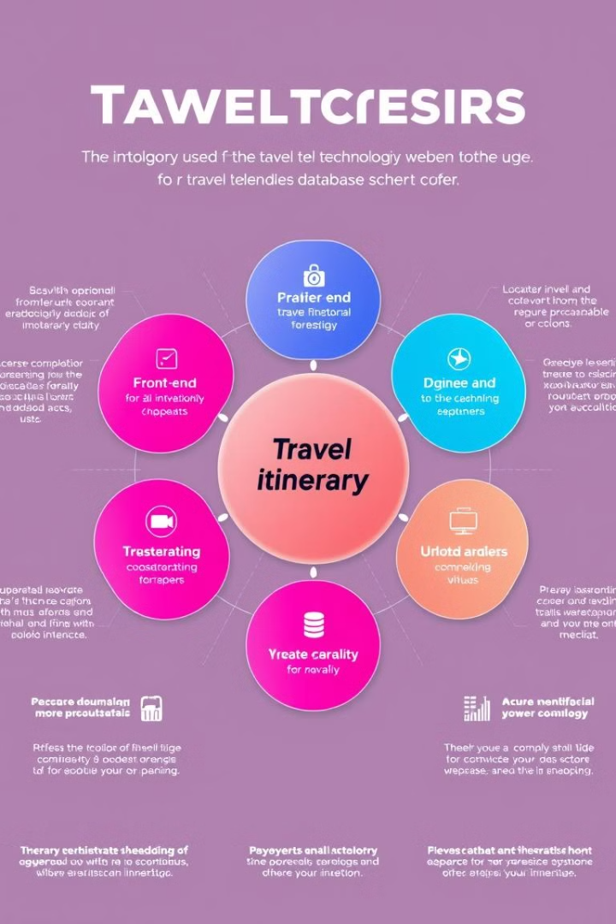
Technology
Stack
Leveraging robust technologies for seamless functionality.
Front-End
HTML, CSS, JavaScript,reactJS
Back-End
NodeJS, express.JS
Database
MongoDB (5Gb)

Slide 10

Benefits
Our website empowers travelers to plan their perfect trip.
1
Time-Saving
Effortlessly plan your itineraries.
2
Cost-Effective
Stay within budget with expense tracking.
3
Enriching Experiences
Discover authentic local experiences.

Slide 11
SON OF PITCHERS
Ayush Saxena (RA2411003010179)
Aditi Thakur (RA2411003010186)
Saalini.T (RA2411003010149)
Afroz (RA2411003010152)
Puneet (RA2411003010213)

